Slide 1
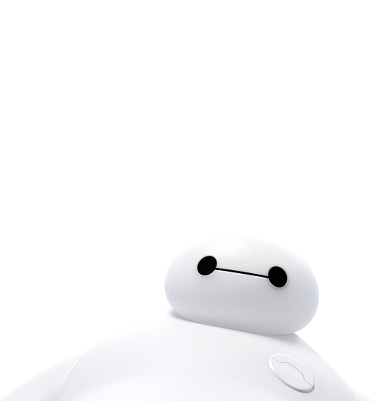
我想要个大白
By 刘卫

Slide 2

大家好
我是大白
HELLO I AM
BAYMAX
Notes:
视频10分钟

Slide 3
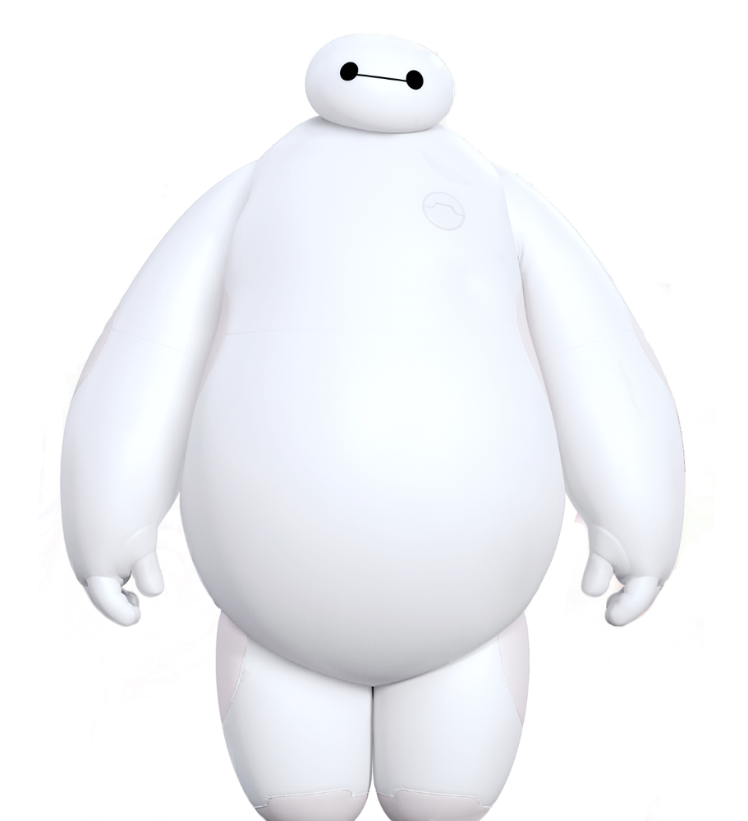
制作大白
Make a baymax
3
2
耳朵
大脑
4
1
心脏
外壳

Slide 4
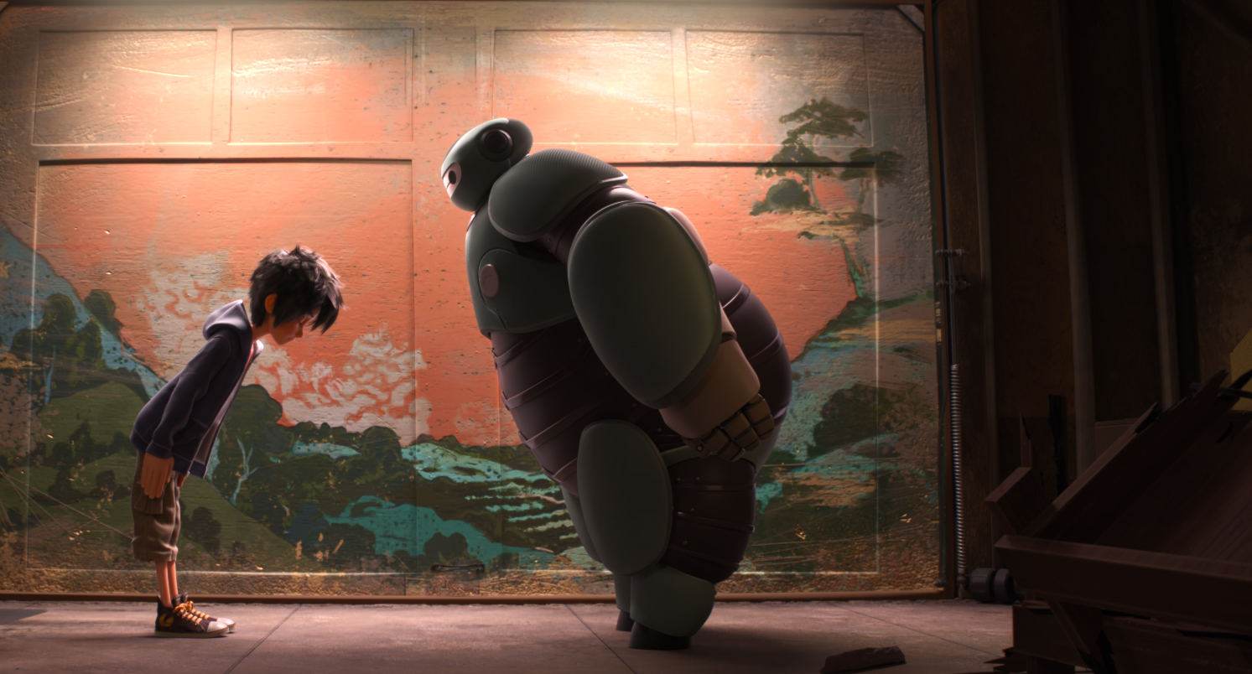
start
开始

Slide 5
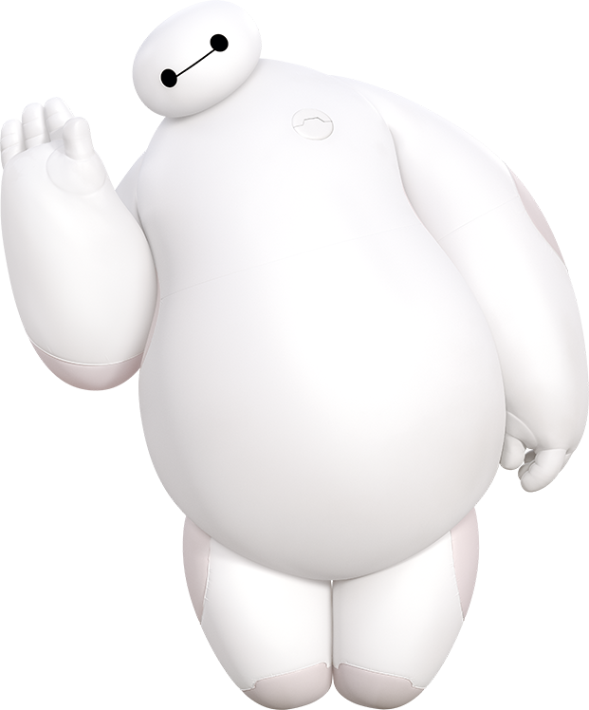
哪些可以做外壳？
1
Part
ONE

Slide 6
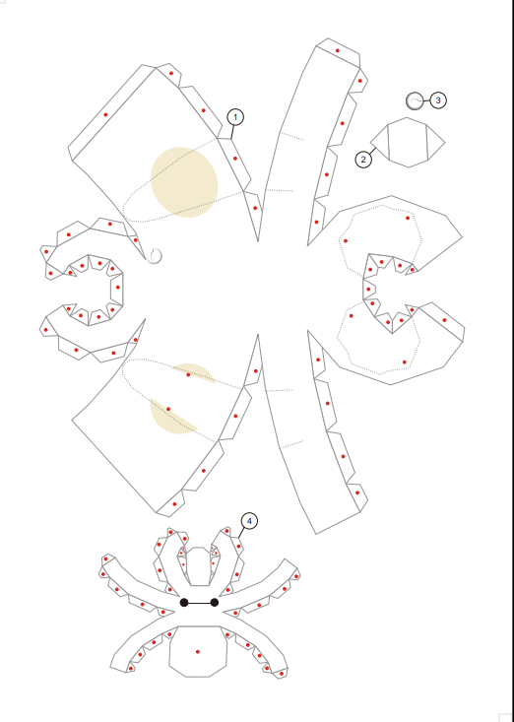
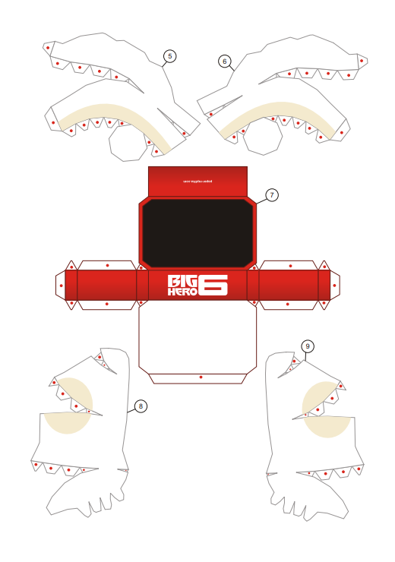
外
壳
纸
like
dislike
Big Hero 6 is a 2014 film about the story of a young robotics prodigy named Hiro Hamada, who forms a superhero team to combat a masked villain responsible for the death of Hiro's older brother.
Who forms a superhero team to combat a masked villain responsible for the death of Hiro's older brother.

Slide 7
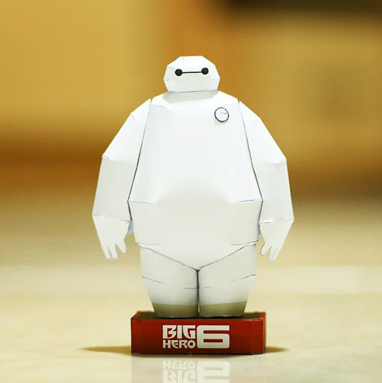
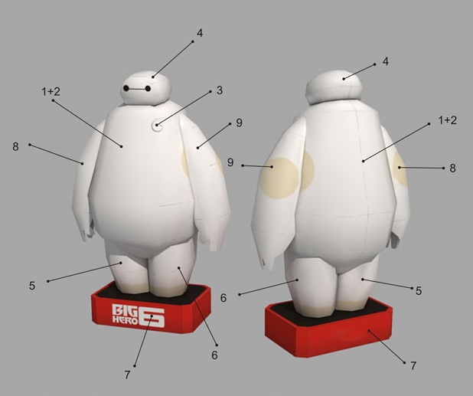
外
壳
纸
like
dislike
Big Hero 6 is a 2014 film about the story of a young robotics prodigy named Hiro Hamada, who forms a superhero team to combat a masked villain responsible for the death of Hiro's older brother.
Who forms a superhero team to combat a masked villain responsible for the death of Hiro's older brother.

Slide 8
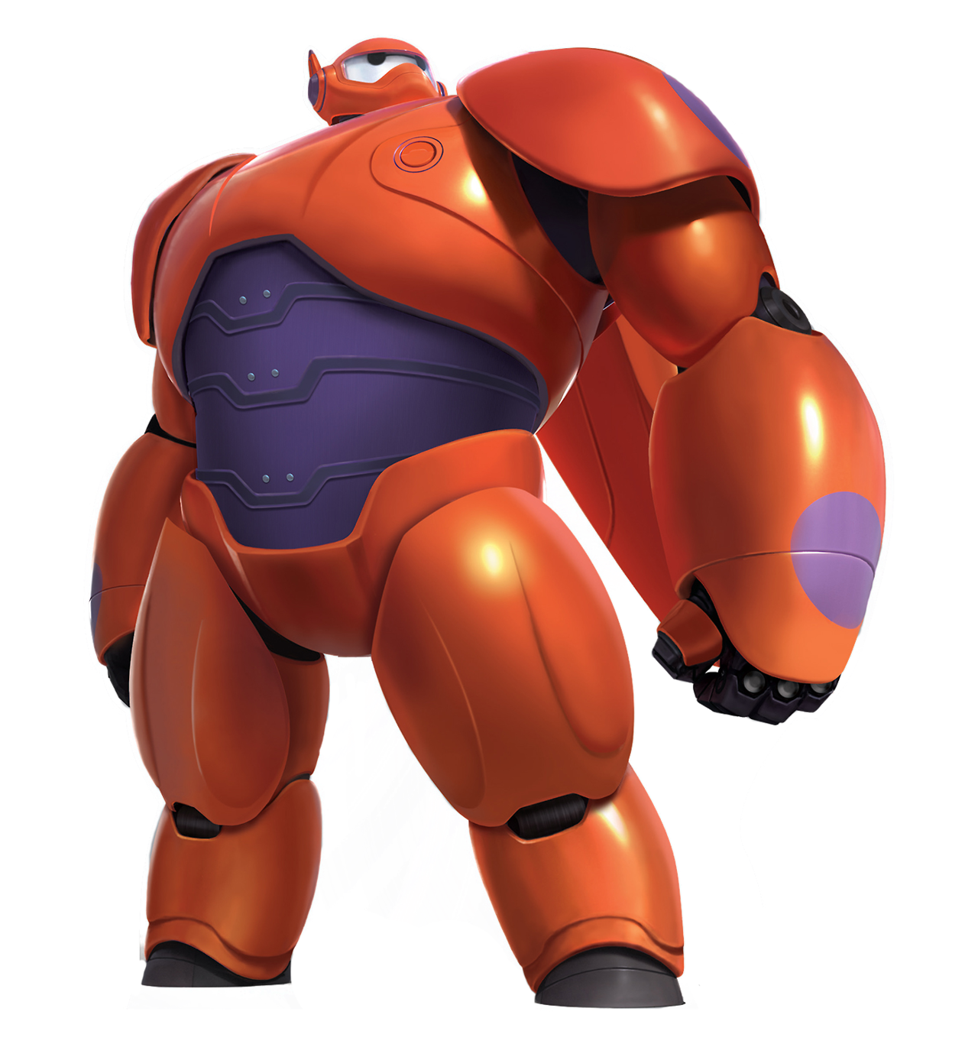
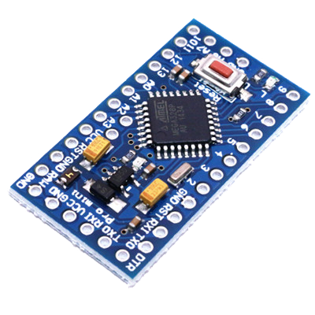
大脑
computer
大脑编号：ATMEGA328P

Slide 9
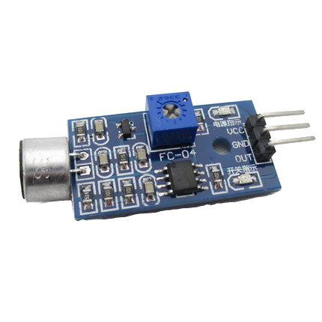
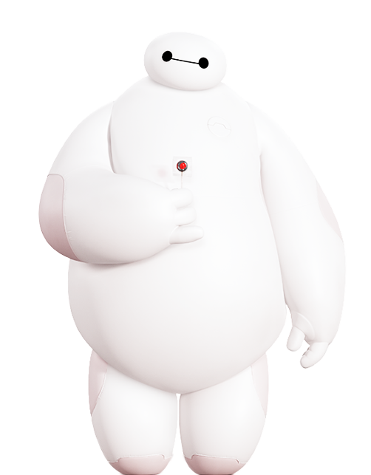
耳朵
Oh, ho.

Slide 10
耳朵-调试
Oh, ho.

Slide 11
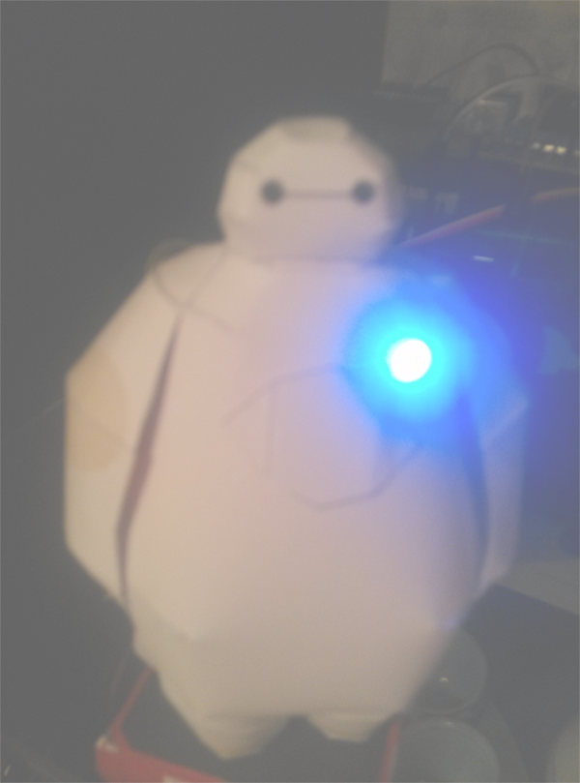
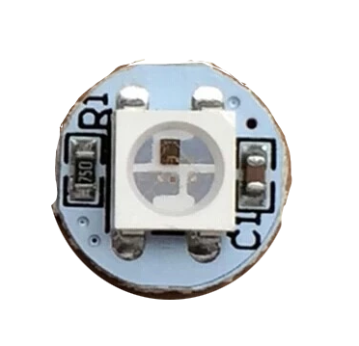

心脏心情
1
2
3
4
5
6
7
8
9
10

Slide 12
耳朵
大脑
心脏

Slide 13
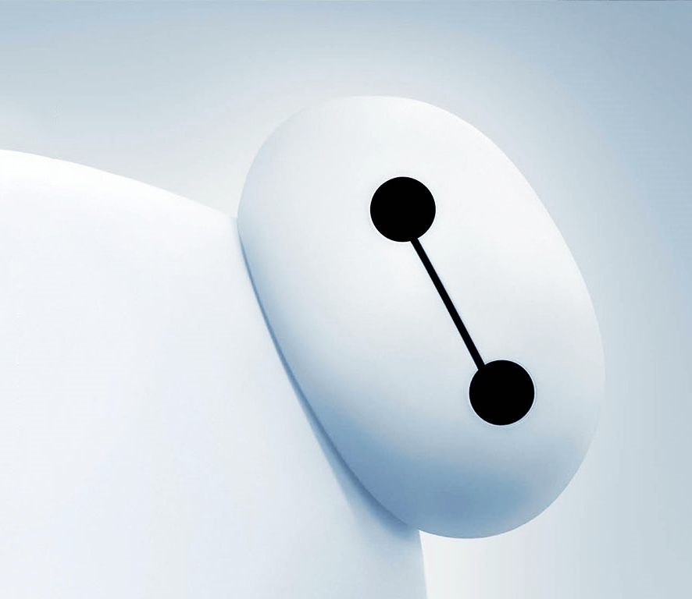
组装
make

Slide 14
THANKS

